Slide 1
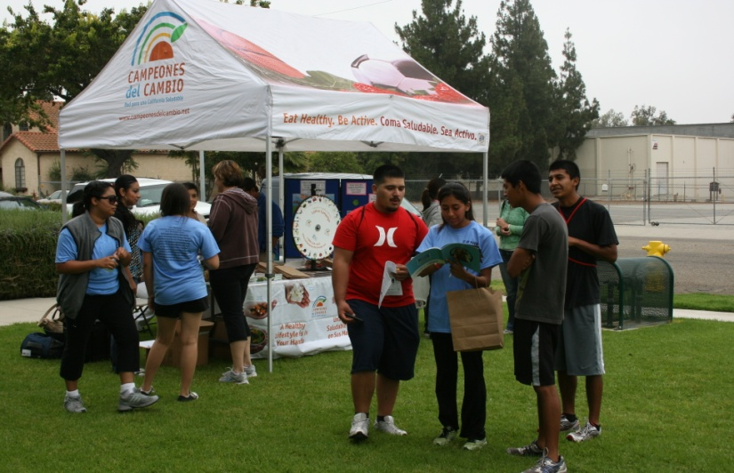
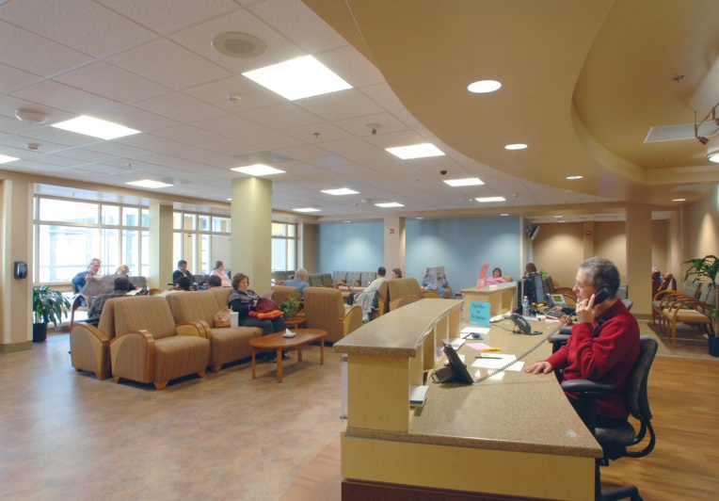
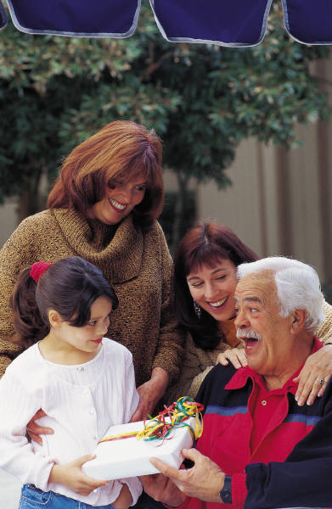
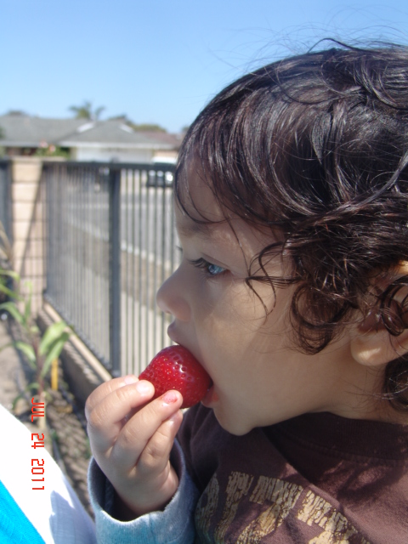
Transforming Ventura County Communities : HEALTHY EATING ACTIVE LIVING
Notes:
1

Slide 2
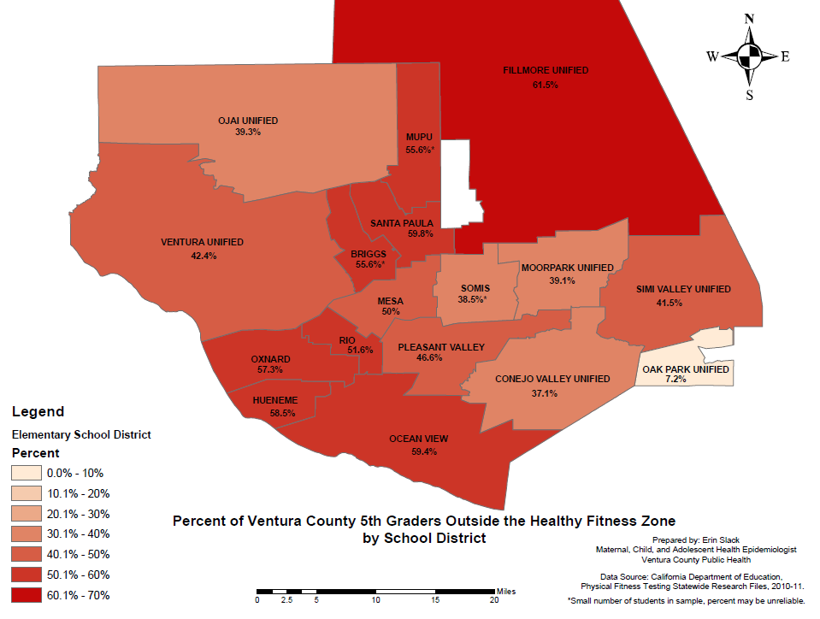
Outside the Healthy Fitness Zone by School District, 5th
Notes:
This map represents the percent of Ventura County 5th Graders Outside the Healthy Fitness Zone by school district. The red represents the percent of 5th graders outside the Healthy Fitness Zone, and the darker the red, the higher percentage of students outside the healthy fitness zone.
As you can see, Fillmore Unified has the highest percentage of students outside the healthy fitness zone while Oak Park has the lowest percentage outside the healthy fitness zone.
Those school districts with the higher percentage of overweight and obese students had the highest percentage of mothers who were overweight or obese.

Slide 3
Outside HFZ by Ethnicity for 5th graders, 2010-11
Data Source: California Department of Education, Physical Fitness Testing Statewide Research Files, 2010-11.
Notes:
This graph shows the percent of 5th graders outside the Healthy Fitness Zone by Elementary School District by ethnicity. In every school district except for Mesa Union which is a very small school, Hispanics are more likely than Whites to be outside the Healthy Fitness Zone. The greatest disparity between Whites and Hispanics occurs in Ojai Unified and Oxnard school districts. Hispanics are almost 2 times more likely to be outside the Healthy Fitness Zone than Whites.

Slide 4
Outside HFZ by Economic Status for 5th graders, 2010-11
Data Source: California Department of Education, Physical Fitness Testing Statewide Research Files, 2010-11.
Notes:
This graph shows the percent of 5th graders outside the Healthy Fitness Zone by Elementary School District by economic status. In every school district except for Oak Park Unified, economically disadvantaged students are more likely to be outside the Healthy Fitness Zone. The greatest disparity between economic status occurs in Ojai Unified and Conejo Valley Unified school districts.

Slide 5
Percent Overweight and Obese by Race, VC Adults
CHIS data does not show great variability by poverty level, but 64.3% of males admitted to being overweight or obese compared to 48.7% of females.
Source: California Health Interview Survey, 2009
*Not Statistically Significant
Notes:
This graph represents the percent of overweight and obese adults by race in Ventura County from the California Health Interview Survey in 2009. Overall, 56.5% of Ventura County adults were overweight or obese, but Latinos were more likely than any other race group to be overweight or obese.
CHIS data does not show great variability by poverty level, but 64.3% of males admitted to being overweight or obese compared to 48.7% of females.

